Slide 1

Fundamentals of Computer Science and Programming
Unit 4 – Programming Part I

Slide 2
Outline
Programming tools
Requirements
Variables
Integers and Floats
Strings
Casting, Printing, Commenting, None-Keyword
Boolean variables and operators
Conditions (if-Statements)
Exercise

Slide 3
Programming tools

Slide 4
How does “text” become an executable program?
When translating source code (“text”)
The computer translates your written code into machine language.
There are two different ways of translation:
Compiler
One-time translation into a binary file (executable)
Interpreter
Interpretation of the source code at each execution

Slide 5
Compiler
Translates source code into machine code
The resulting executable (file) only contains computer instructions
The executable is no more human readable
Saved as binary file (executable)
Translation takes place only once!
This process is also called compilation
The computer directly executes the program (executable)
print(”Hi”)
…
000100111101101100110111010
compile
Source code
Executable file (.exe)

Slide 6
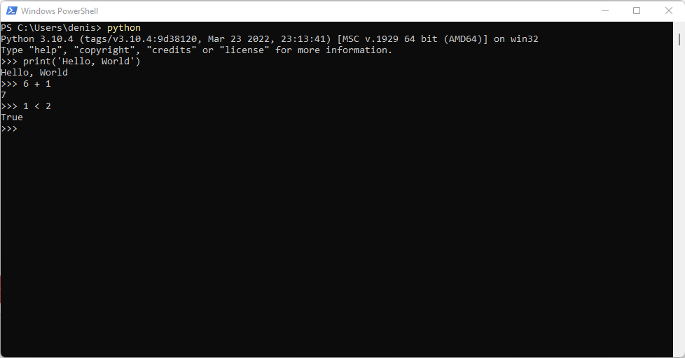
Interpreter
Similar to the compiler
The program gets executed using computer instructions, but:
Each command (e.g. print(“Hi”)) gets translated on its execution
No additional binary file (executable) is created
Source code gets translated on each execution
This process is called “interpretation”
Compilers can lead to drastic performance advantages

Slide 7
Basic terms in programming languages
Programming language
Formal language with fixed rules
Syntax
Fix rules on how to write in a programming language
Fix rules for all language elements
Semantics
Meaning of the language elements
What is exectued?
Program logic, program flow, program structure
Execution sequence and interplay between different program parts

Slide 8
Requirements

Slide 9
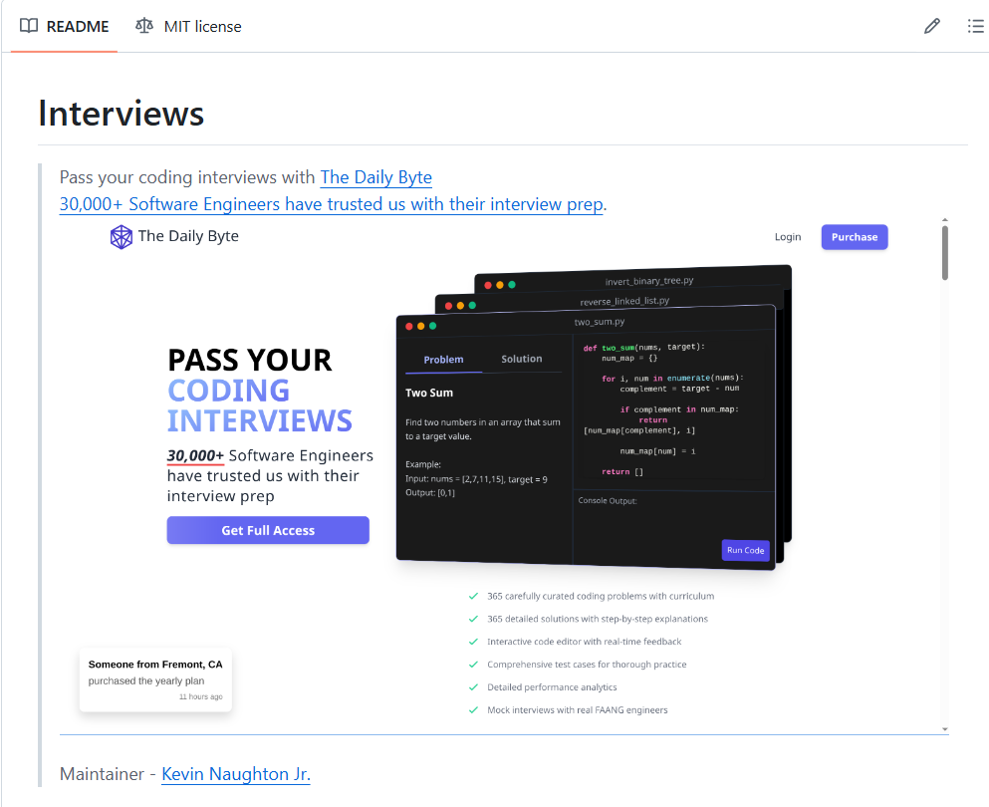
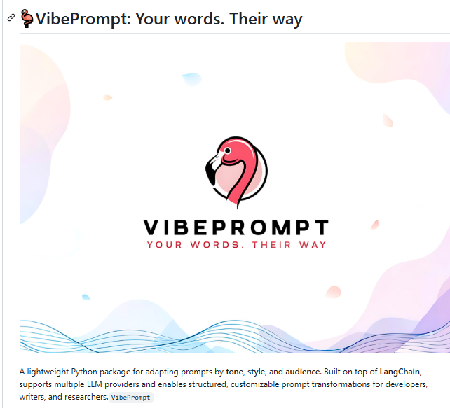
GitHub
Not Only for Programming – A free and Shared Resource Hub for Creativity and Productivity
Code Sharing
Dataset Sharing
Resource Sharing
Personal Knowledge Base & Version Control
Can store, organize, and manage your projects, notes, and knowledge — with every change tracked over time.

Slide 10
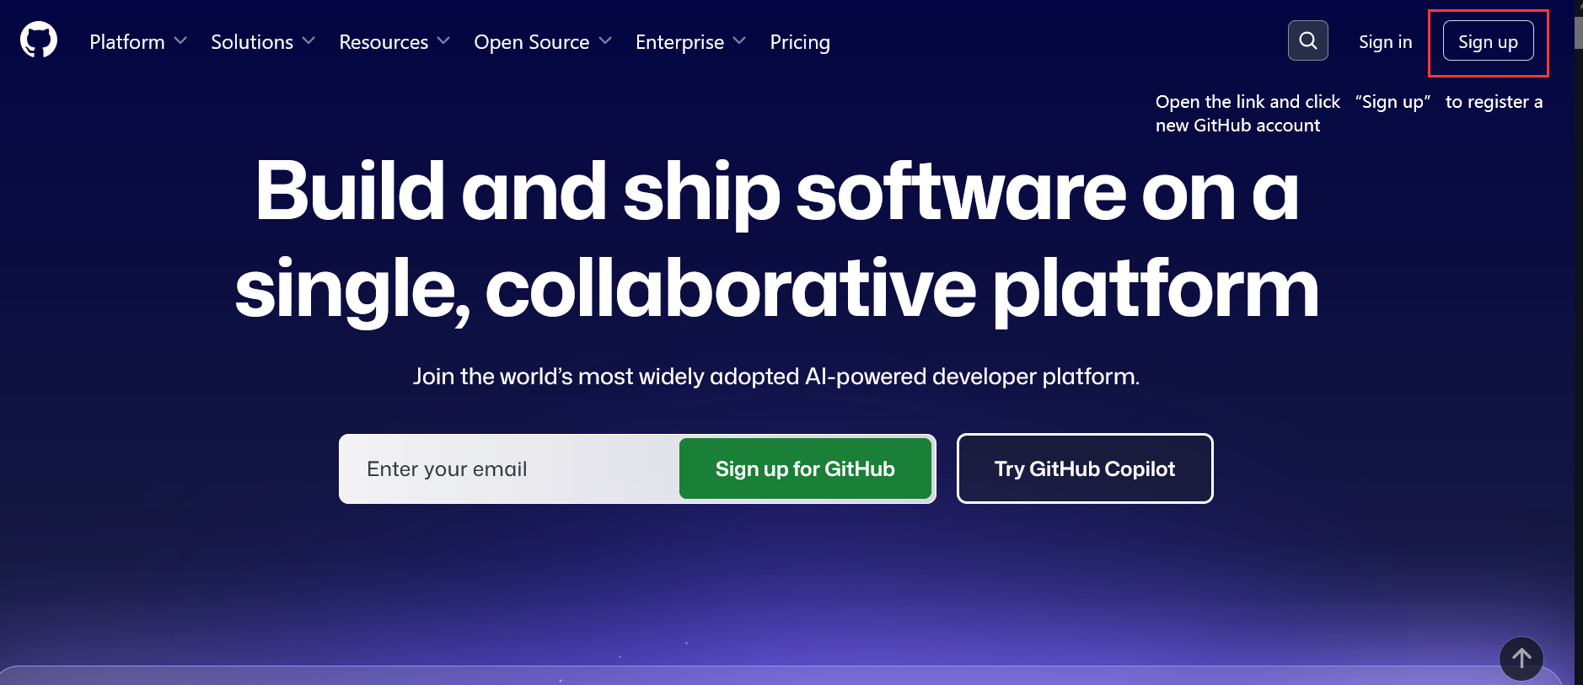
Sign in
Step 1: https://github.com open the link and sign up your own account based on the instruction.

Slide 11
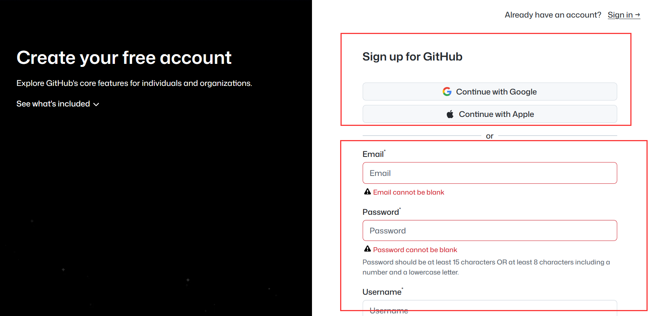
Sign in
Step 1: Sign up using your Google or Apple ID, or create a new account with your email address.

Slide 12

Sign in
Step 2: Sign in with the account you just created.

Slide 13
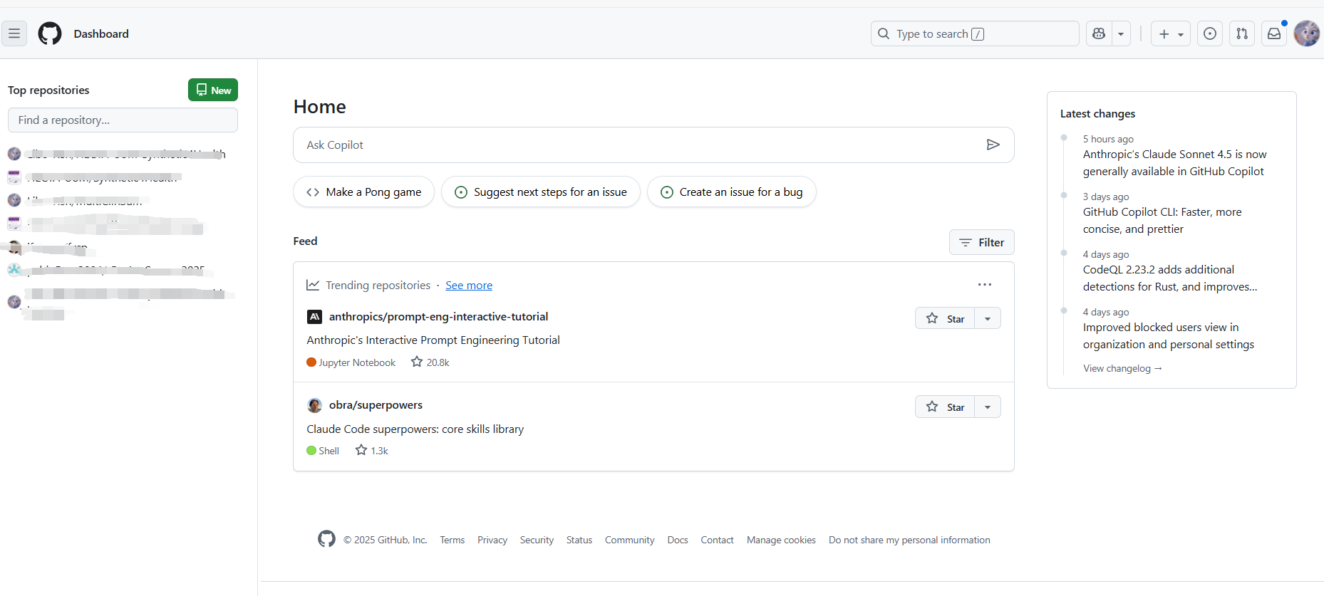
Homepage

Slide 14
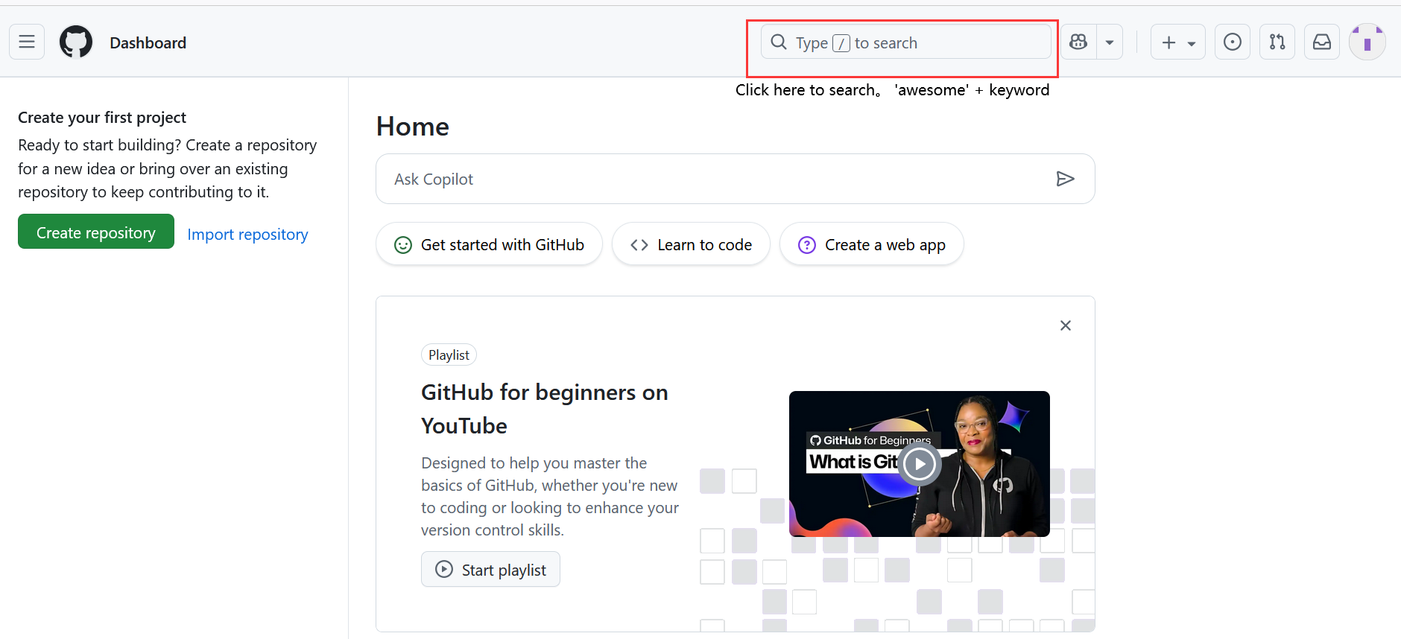
Resource Hub
Try searching “awesome + keyword” (awesome list)

Slide 15
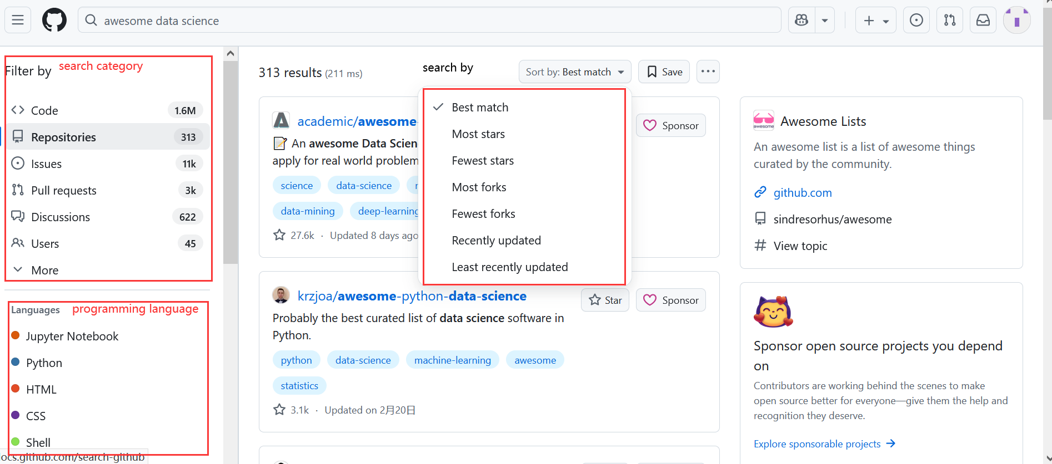
Resource Hub
Try searching “awesome + keyword” (awesome list) [e.g. ‘awesome data science’]

Slide 16
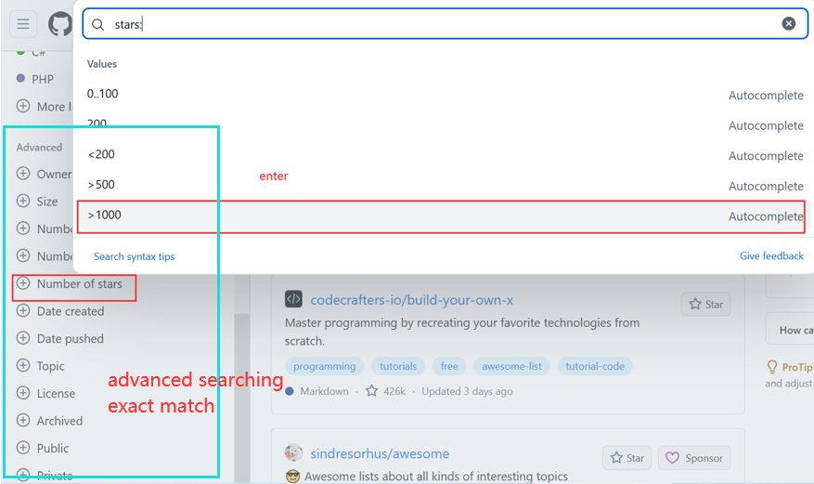
Resource Hub
Try searching “awesome + keyword” (awesome list) [e.g. ‘awesome data science’]

Slide 17
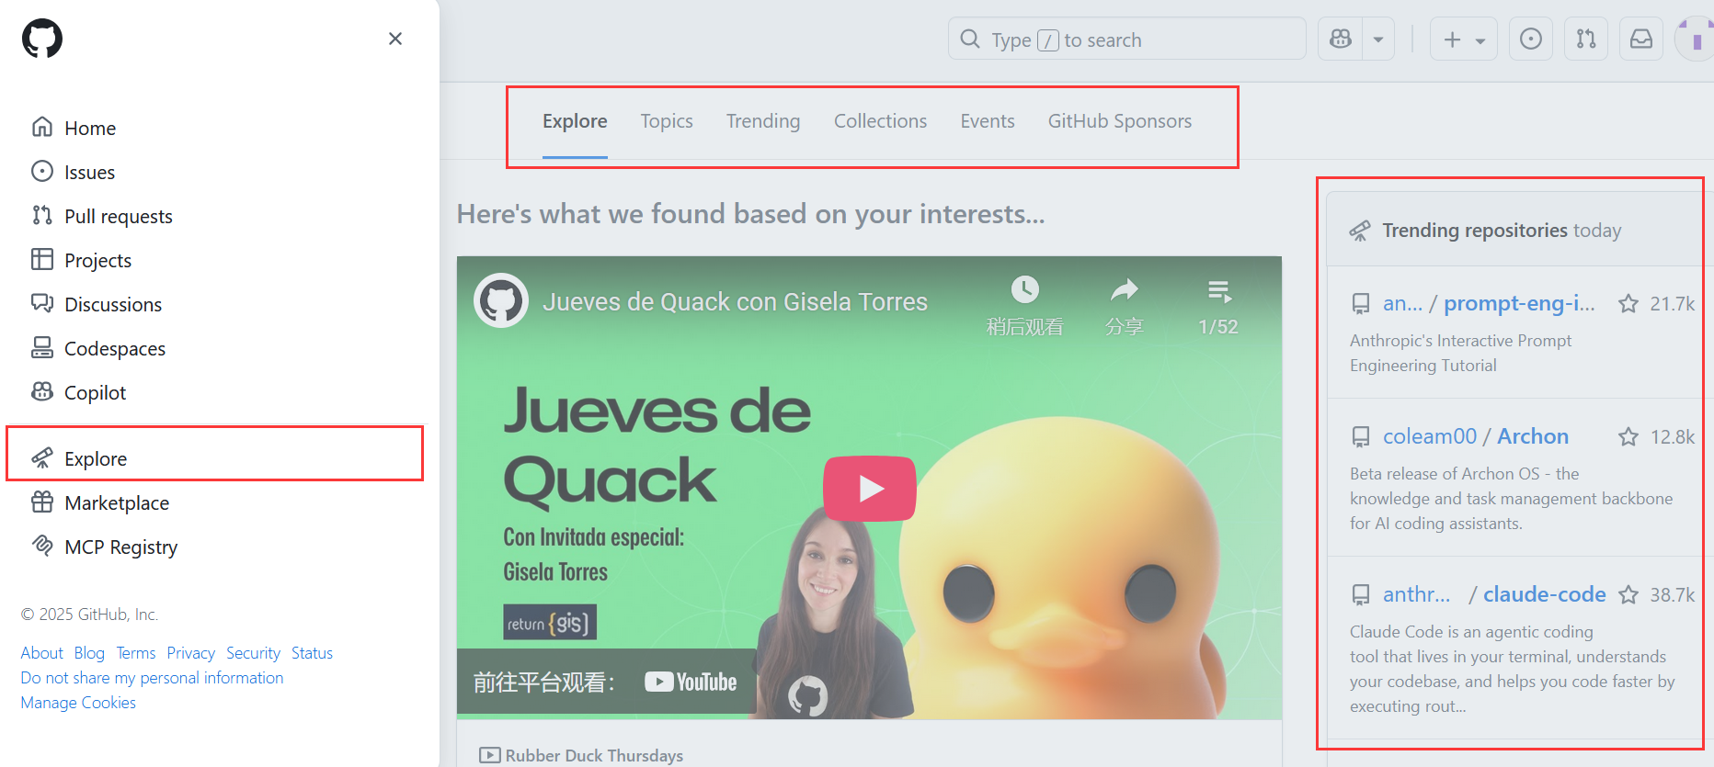
Resource Hub
If you don’t have a specific search goal, just click “Explore.” Use it like a social media platform (similar to Instagram or Twitter.)

Slide 18
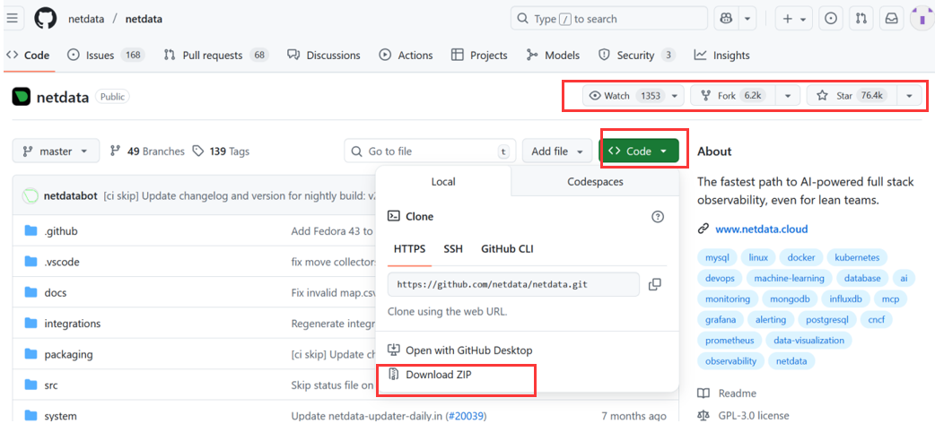
Resource Hub
View and download the project
watch: receive notifications about changes
fork: create your own copy of this repo
star: bookmark or like the project
copy the repo to your local machine
three ways to clone the repo
Always use “Download ZIP” to get the project.

Slide 19
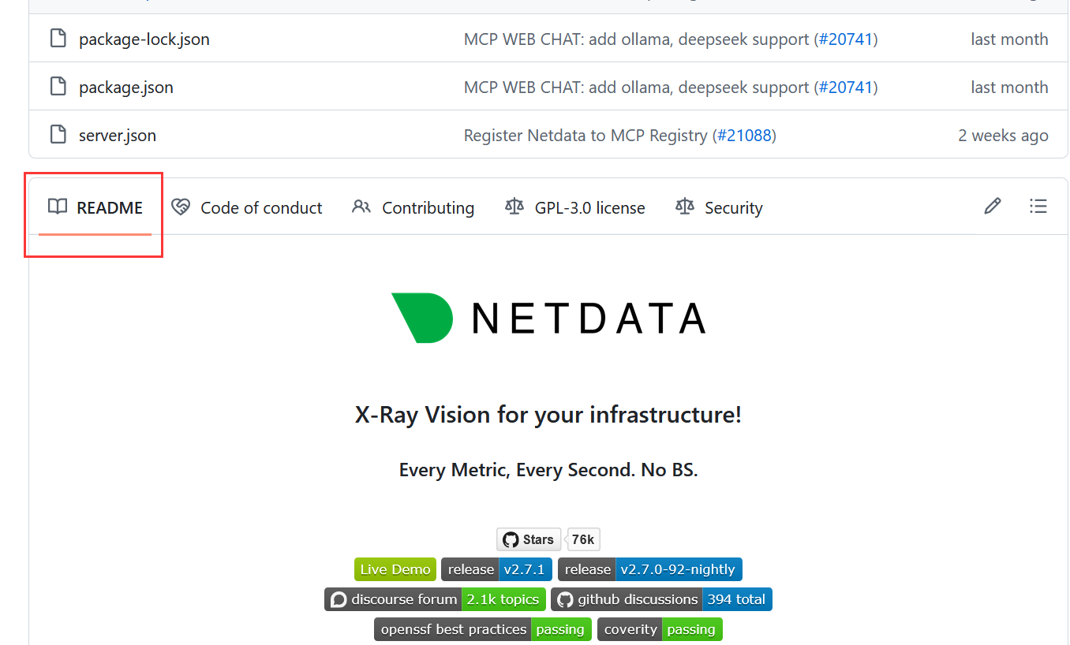
Resource Hub
README is very important because it usually includes an introduction, installation guide, and instructions on how to use the resources you downloaded.

Slide 20
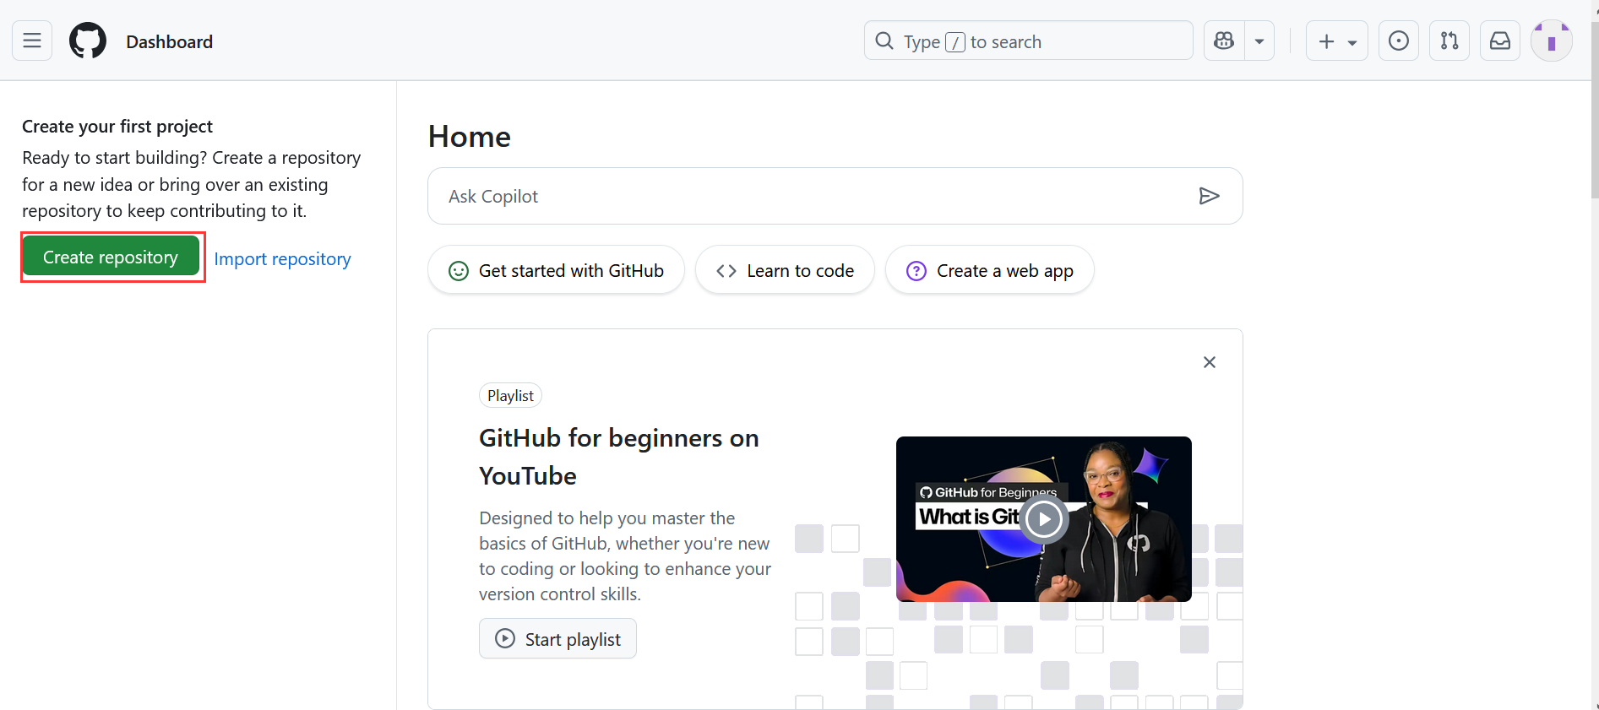
Personal Knowledge Base
Create and share your own project (called “repositories” on GitHub).

Slide 21
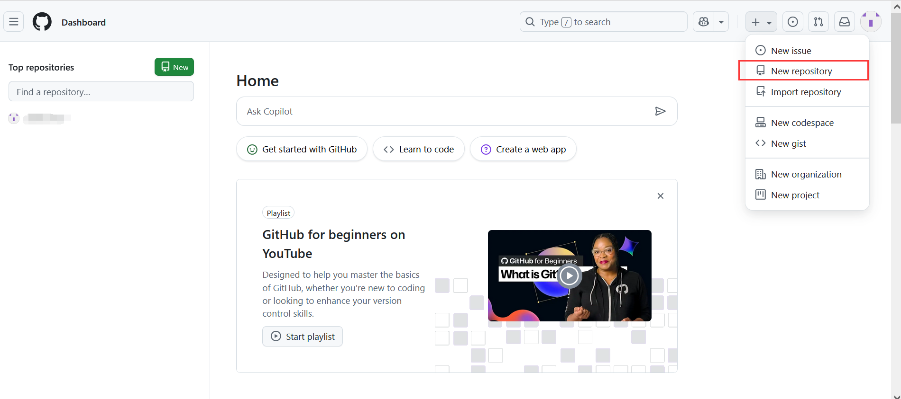
Personal Knowledge Base
Create and share your own project (called “repositories” on GitHub).

Slide 22
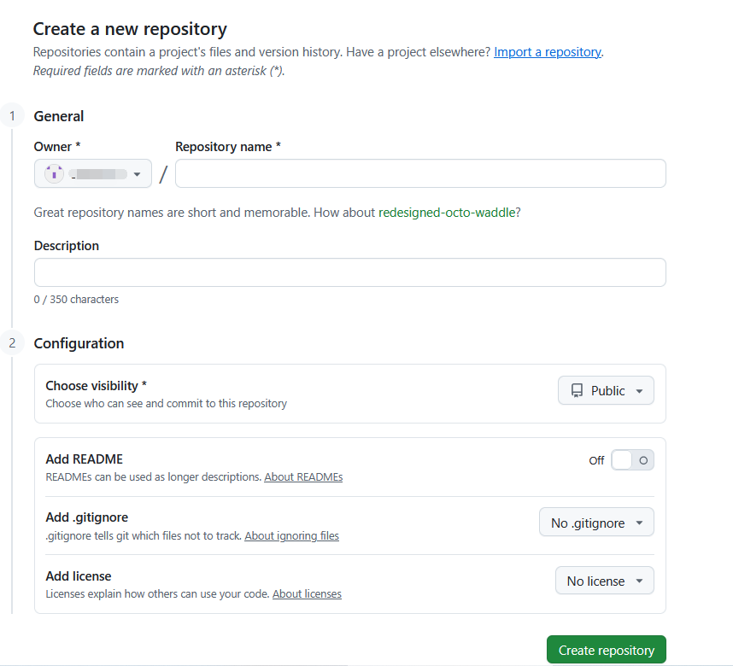
Personal Knowledge Base
Create and share your own project (called “repositories” on GitHub).
default
name of your project
click here to add README
No .gitignore means no files will be ignored — every file will be tracked.

Slide 23
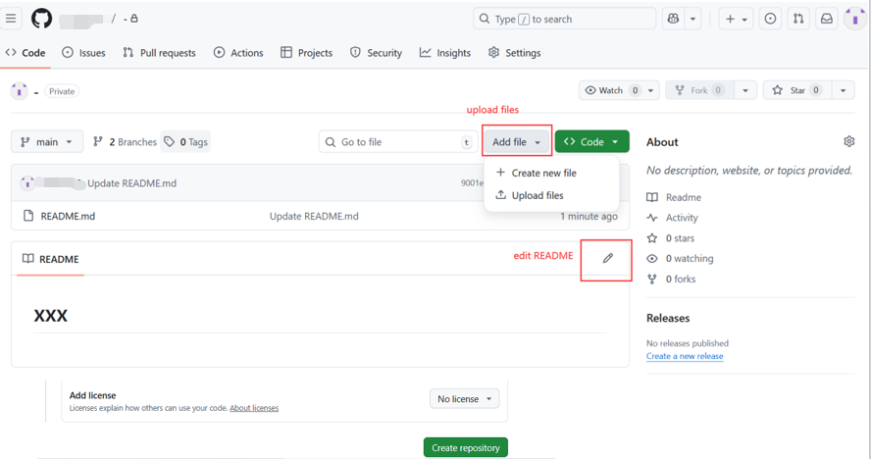
Personal Knowledge Base
Create and share your own project (called “repositories” on GitHub).

Slide 24
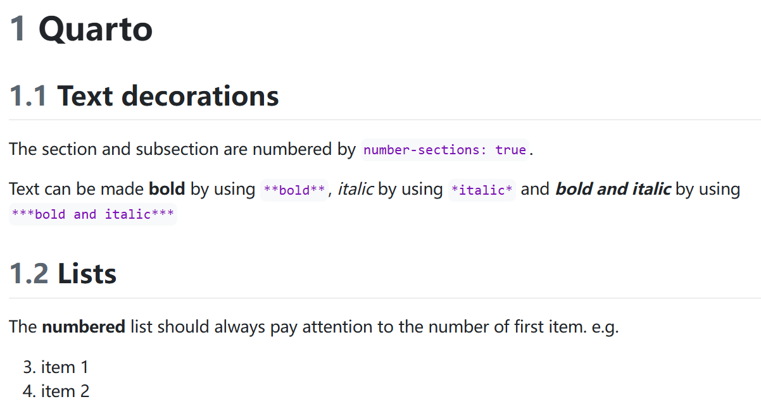
Personal Knowledge Base
README: Follow the syntax of Markdown.
e.g.
# title ## subtitle **bold** *italic*
See the link below for more detailed syntax. https://www.markdownguide.org/basic-syntax/

Slide 25
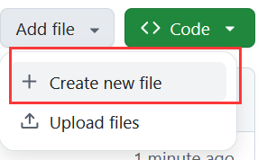
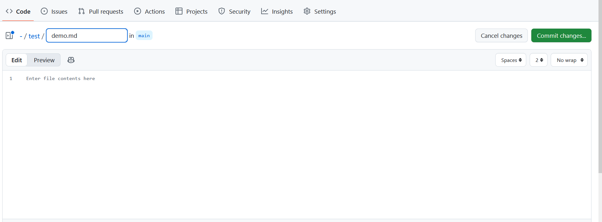
Personal Knowledge Base
Create folder: create file -> folder name/ -> file name

Slide 26
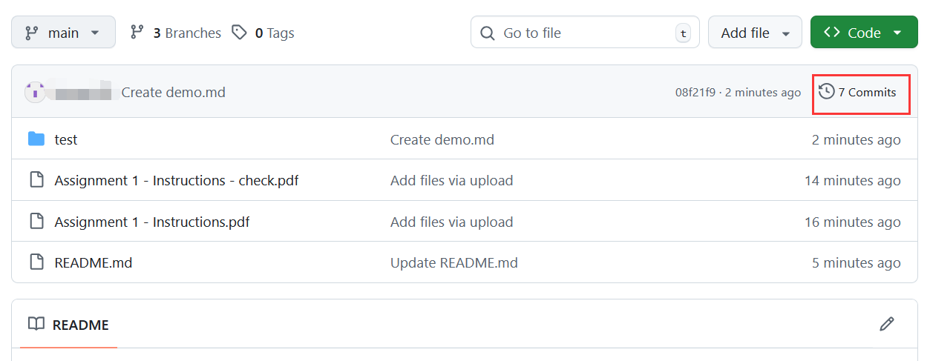
Personal Knowledge Base
View previous version
View commit history

Slide 27
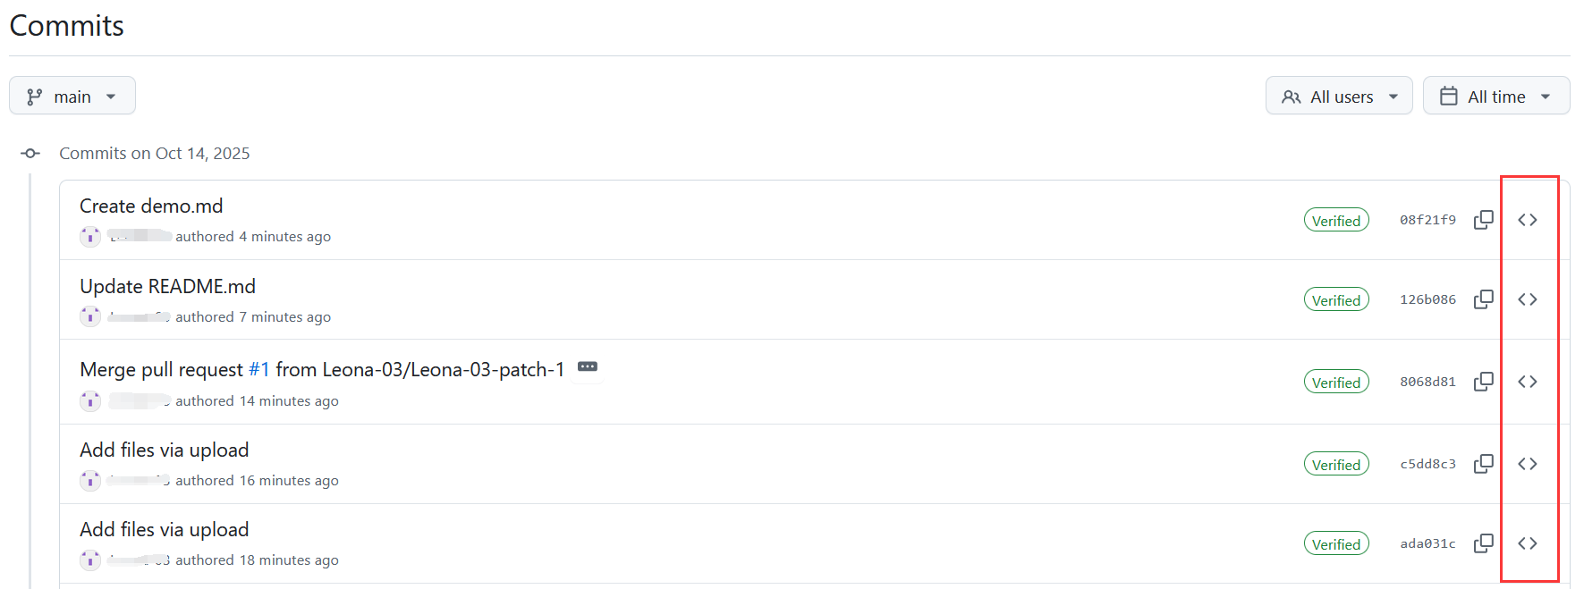
Personal Knowledge Base
Create folder: create file -> folder name/ -> file name
View commit history
View the unmodified version

Slide 28
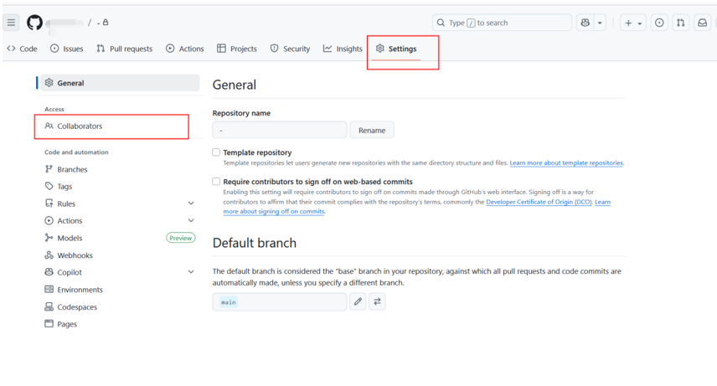
Personal Knowledge Base
Change the repository settings and add collaborators.

Slide 29
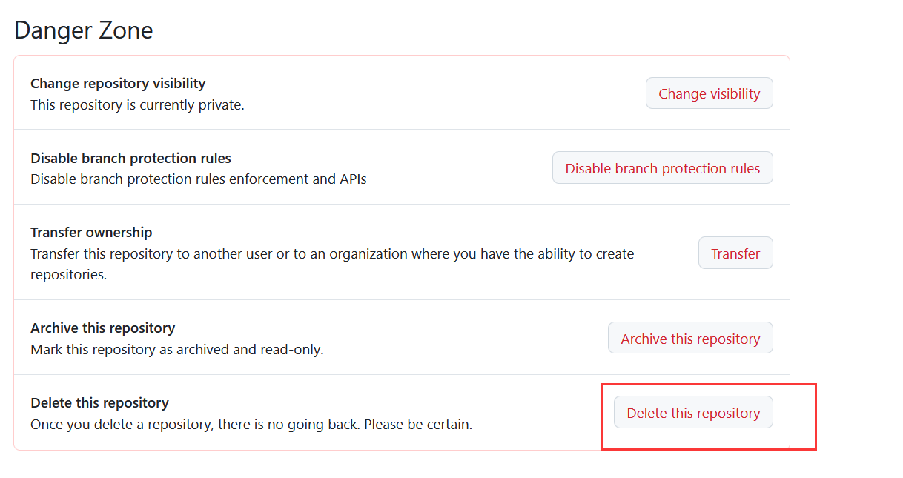
Personal Knowledge Base
Delete the repository: Settings -> Danger Zone

Slide 30
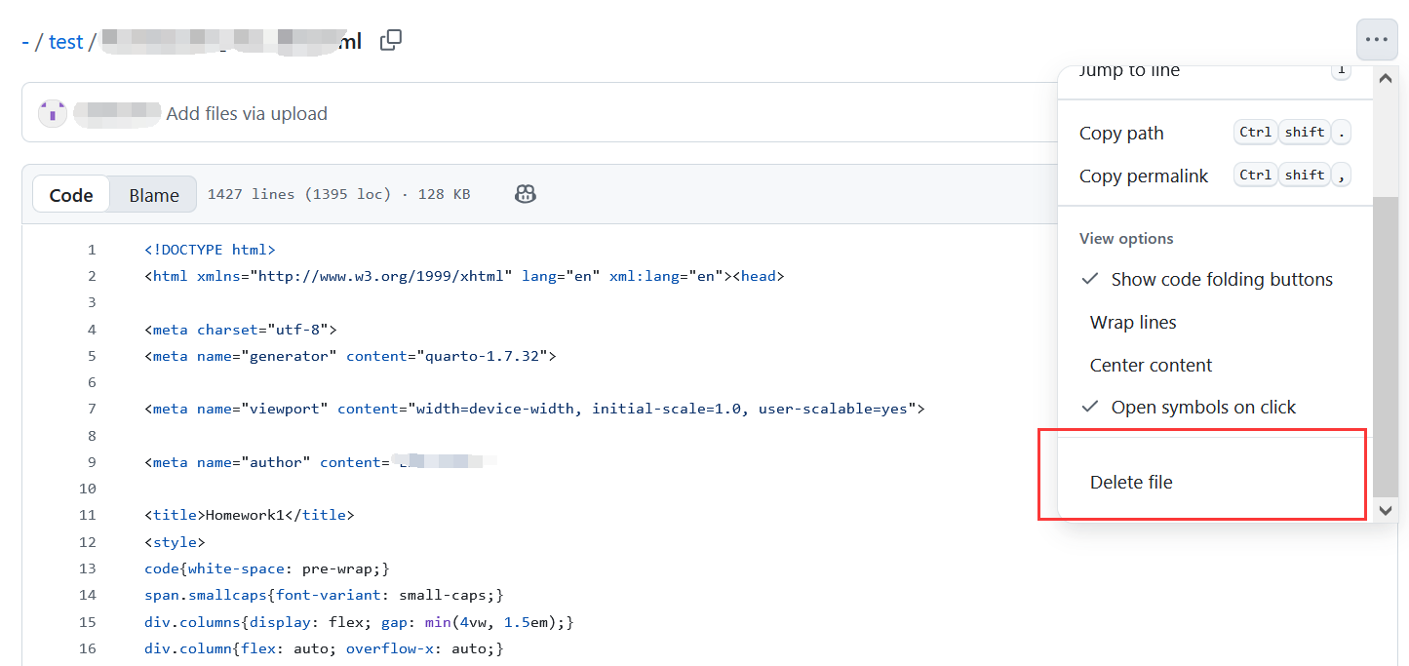
Personal Knowledge Base
Delete the file

Slide 31
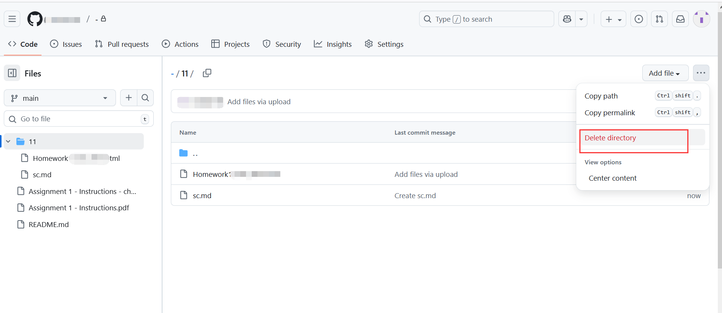
Personal Knowledge Base
Delete the folder

Slide 32
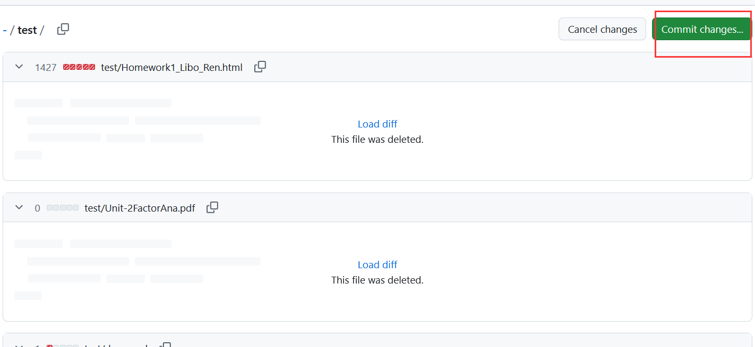
Personal Knowledge Base
Delete the folder

Slide 33
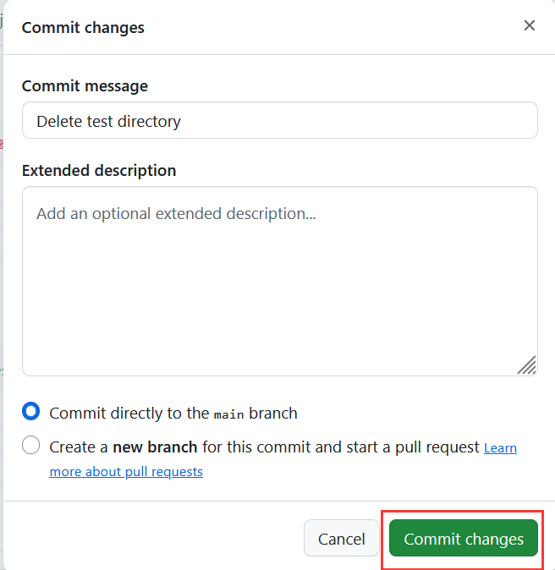
Personal Knowledge Base
Delete the folder

Slide 34
Requirements
Computer (Mac OSX, Linux, Windows)
No tablet
No smartphone
Python3 interpreter
Integrated Development Environment (IDE)
Jupyter Notebook / Jupyter Lab
Installation instruction: https://github.com/dhelic/focsp/blob/main/installation.md
Windows: https://www.youtube.com/watch?v=Kn1HF3oD19c
Macbook: https://www.youtube.com/watch?v=nhv82tvFfkM&t=163s (p.s.The steps shown for Python 3.12 also apply to Python 3.10.)

Slide 35
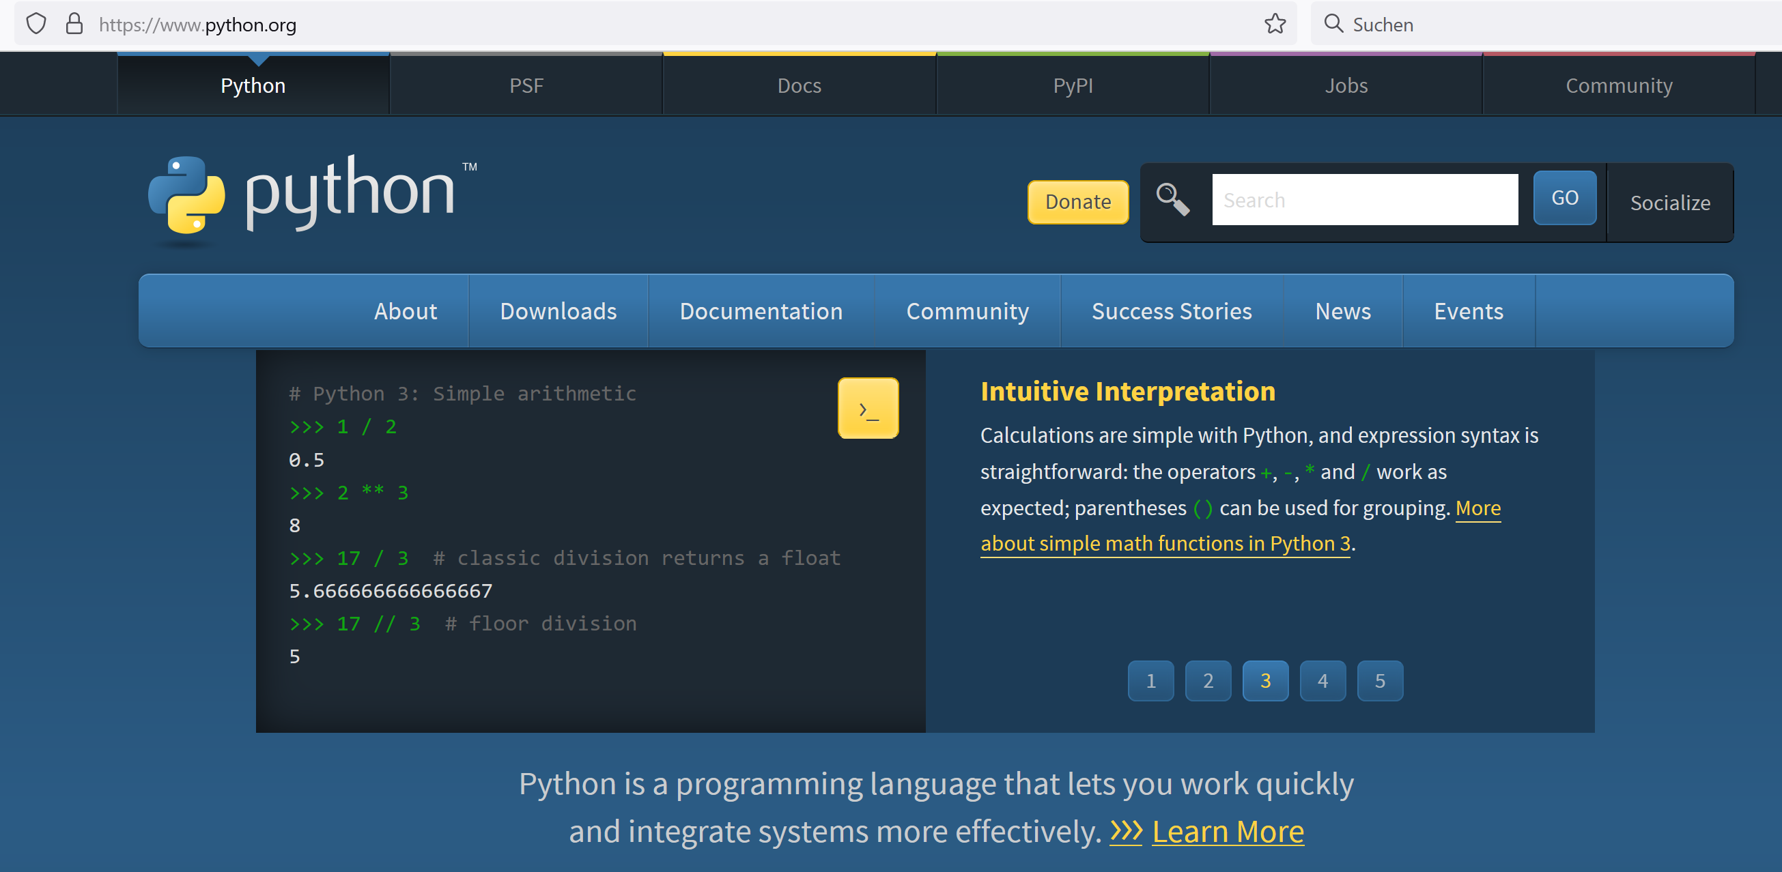
Python (www.python.org)

Slide 36
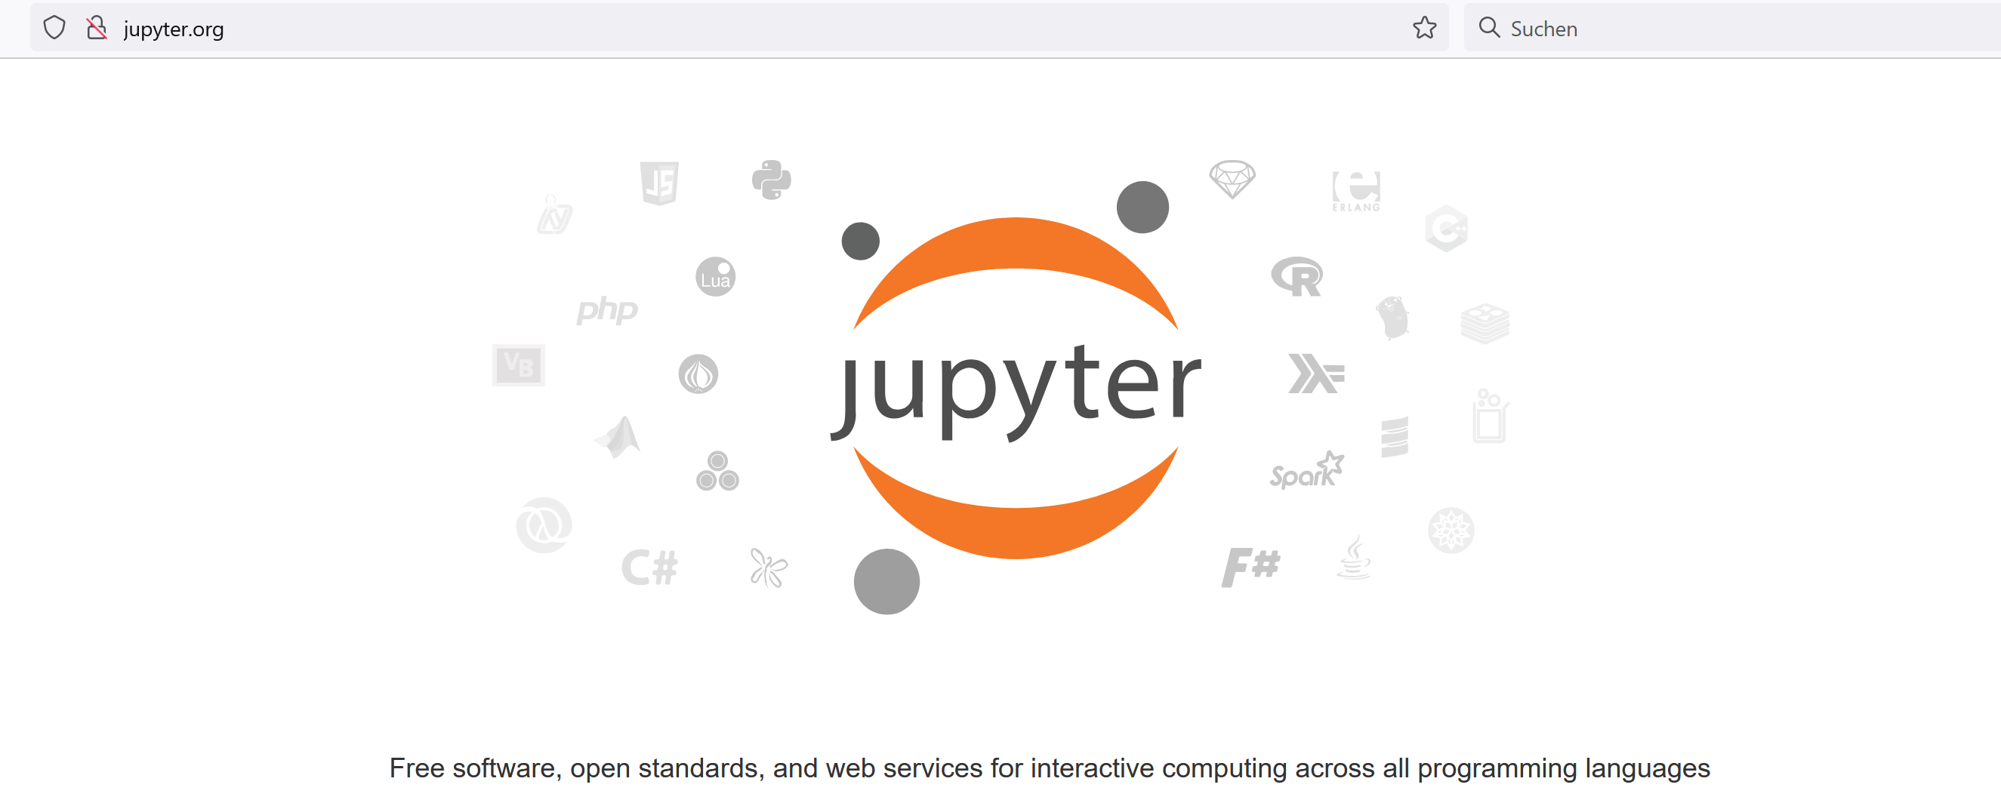
Jupyter (www.jupyter.org)

Slide 37
Python3
Python 3.10 is recommended for the exercise
Good readability, clear structure
Interpreted
Runs on all common OS

Slide 38
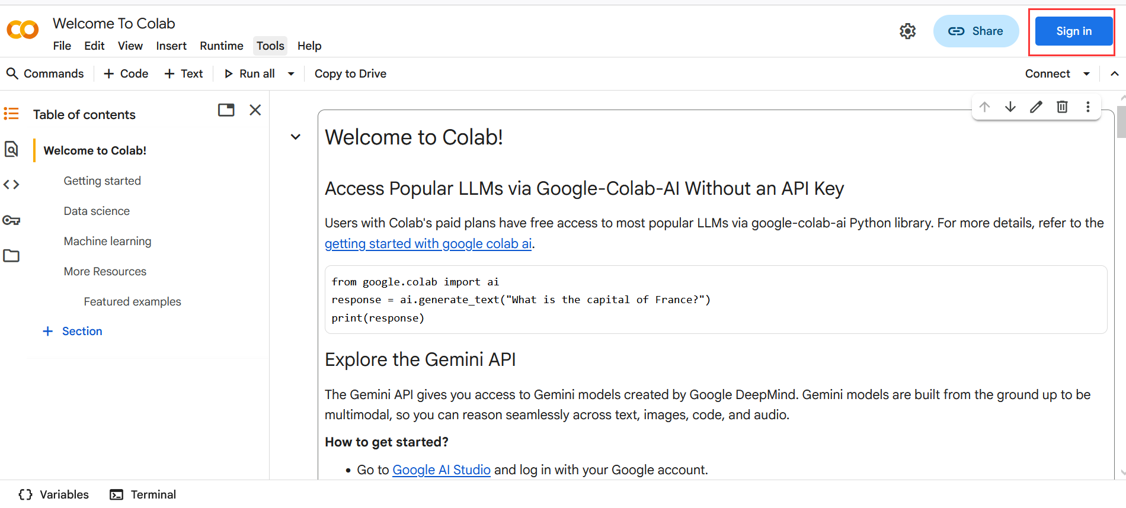
Google Colab
Open the link: https://colab.research.google.com/?hl=en and sign in with your Google account

Slide 39
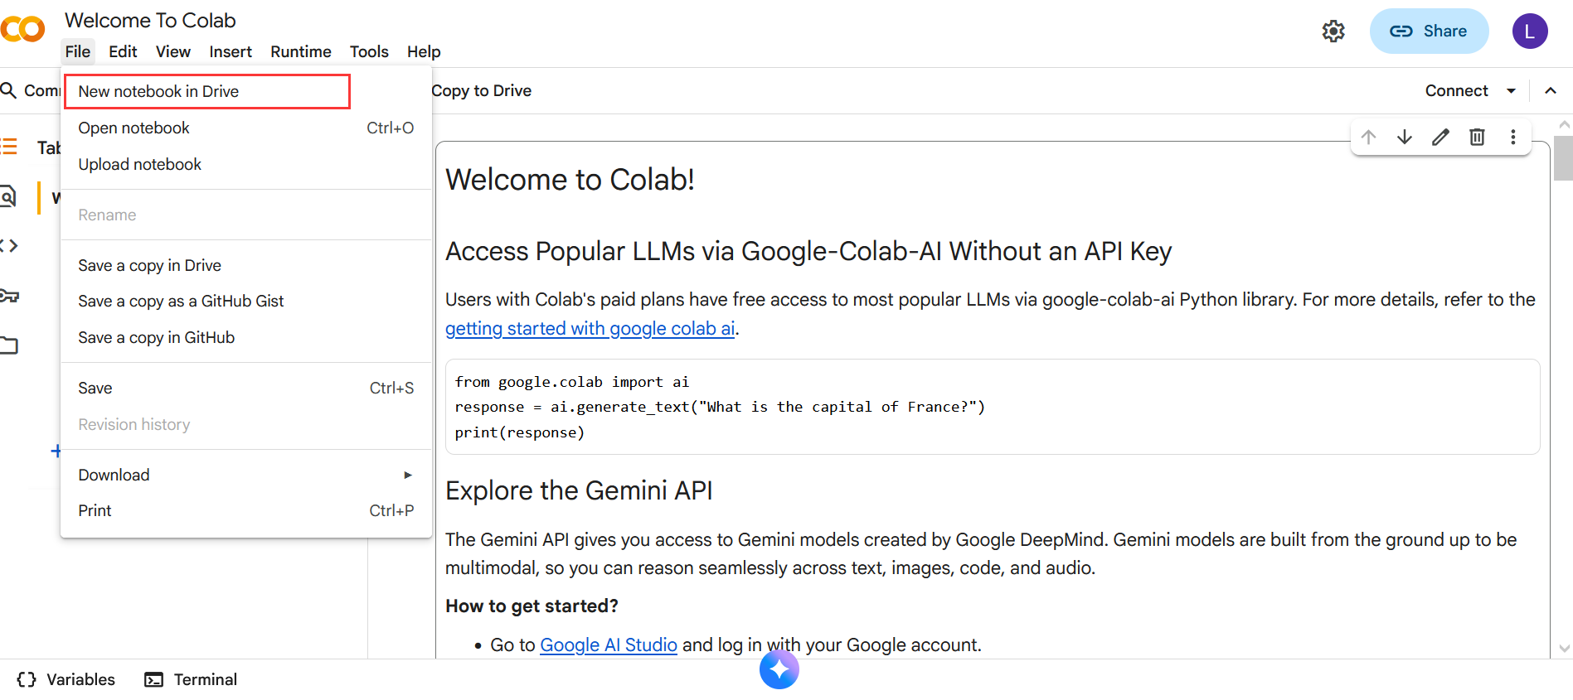
Google Colab
Create a new notebook. It will be automatically saved in Google Drive.

Slide 40
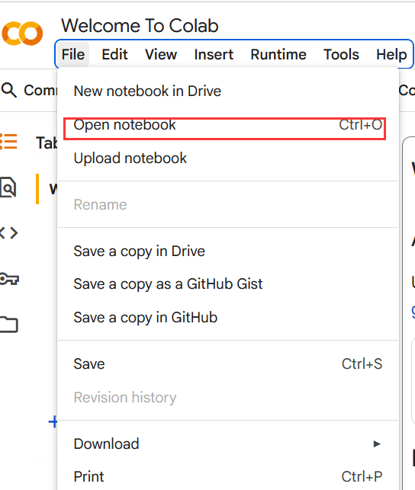
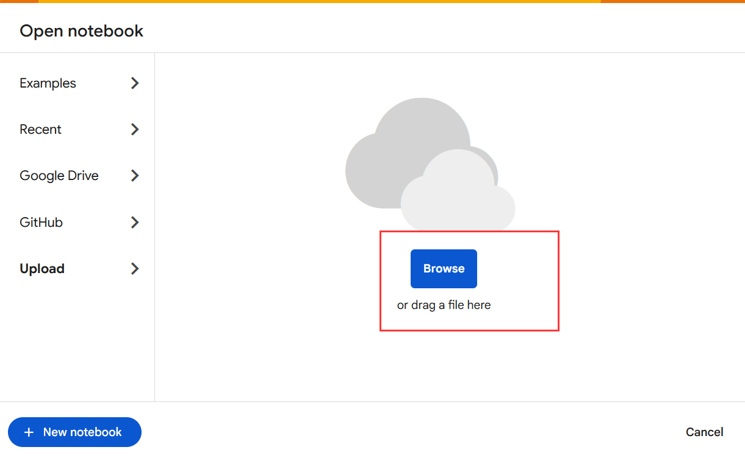
Google Colab
Open the given notebook
Choice 1: upload from local machine

Slide 41
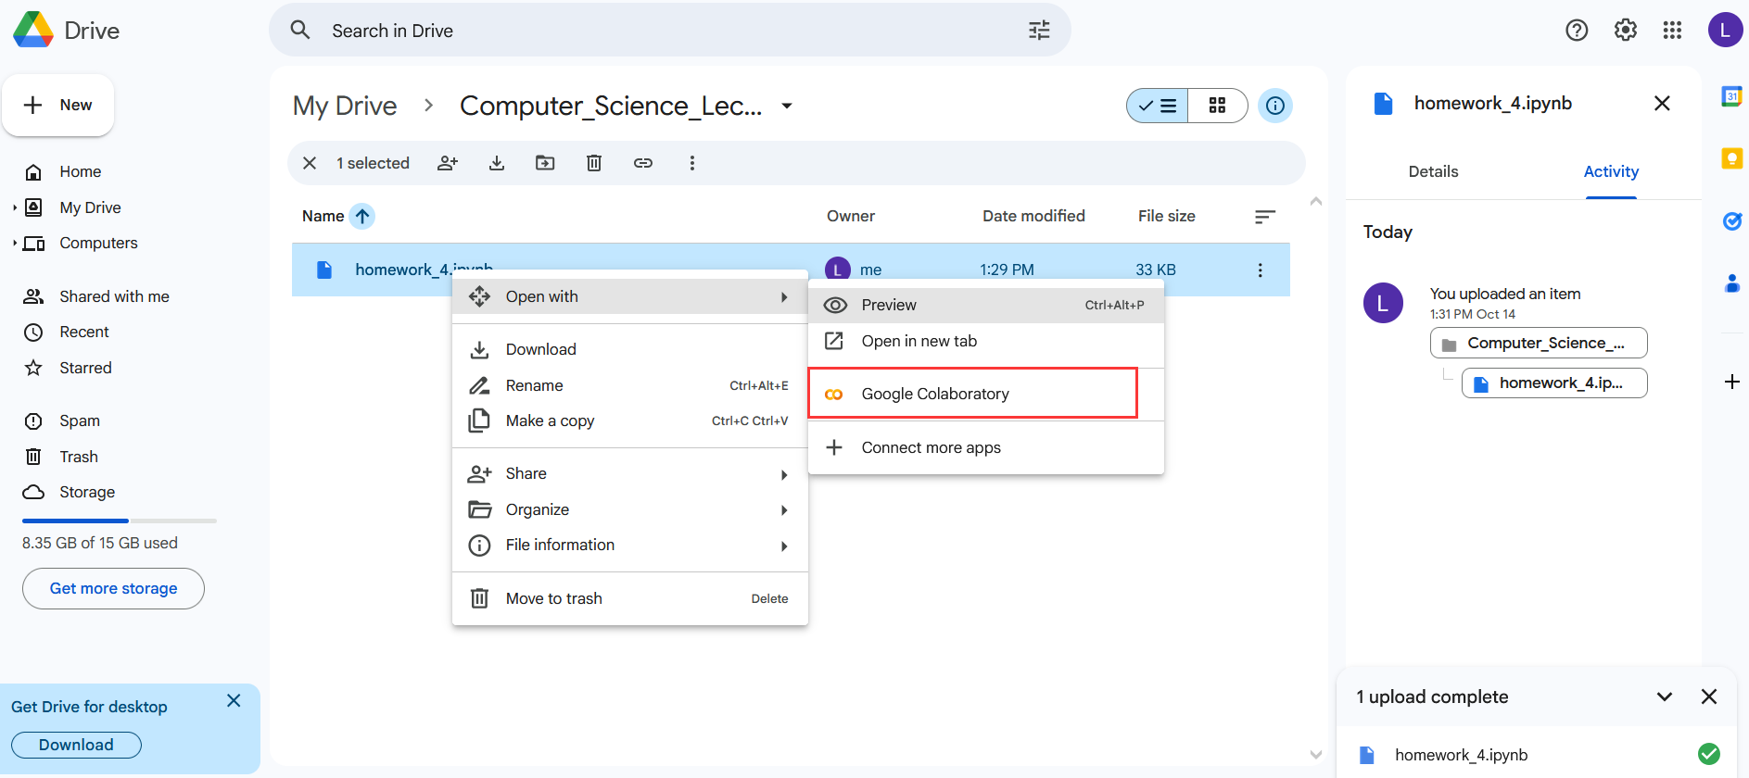
Google Colab
Open the given notebook
Choice 2: Upload from Google Drive — open the folder that contains the notebook, then open it with Colab.

Slide 42
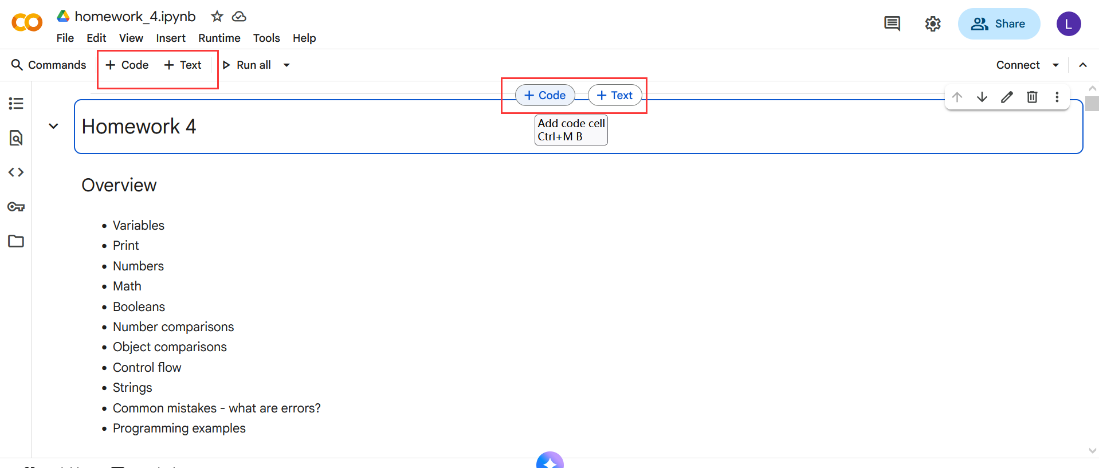
Google Colab
A notebook is organized into several code cells and text cells.
For text cells, we need to follow Markdown syntax.
For code cells, we can write code in Python or R.

Slide 43
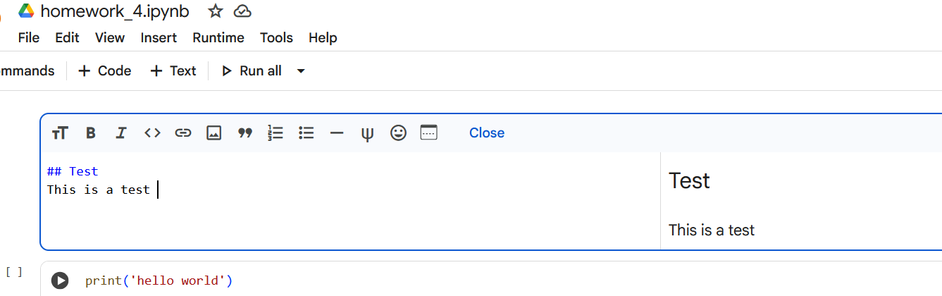
Google Colab
A notebook is organized into several code cells and text cells.
For text cells, we need to follow Markdown syntax.
For code cells, we can write code in Python or R.

Slide 44
Google Colab
A notebook is organized into several code cells and text cells.
For text cells, we need to follow Markdown syntax.
For code cells, we can write code in Python or R.

Slide 45
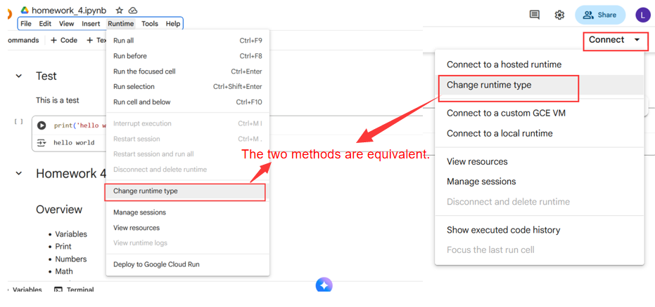
Google Colab
Change runtime settings (e.g., choose CPU or GPU, select the interpreter such as Python or R, etc.).The two methods are equivalent.

Slide 46
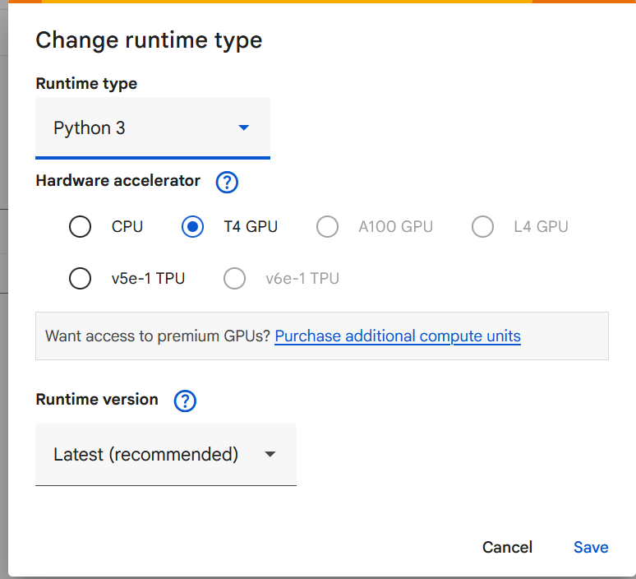
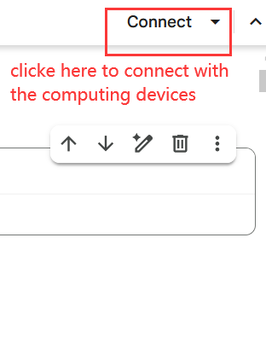
Google Colab
Change runtime settings (e.g., choose CPU or GPU, select the interpreter such as Python or R, etc.).

Slide 47
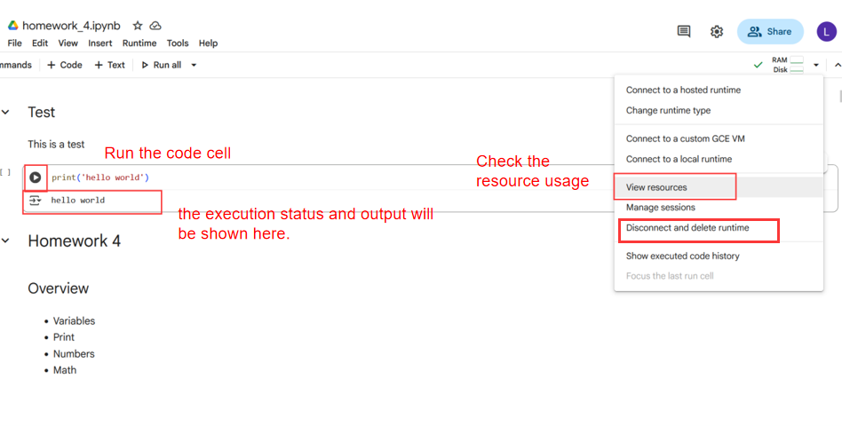
Google Colab
Change runtime settings (e.g., choose CPU or GPU, select the interpreter such as Python or R, etc.).

Slide 48
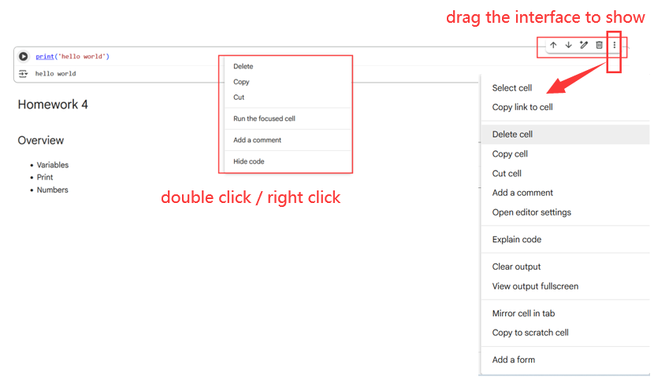
Google Colab
Edit or delete the cell: 3 methods: double-click / right-click / drag the interface to show it

Slide 49
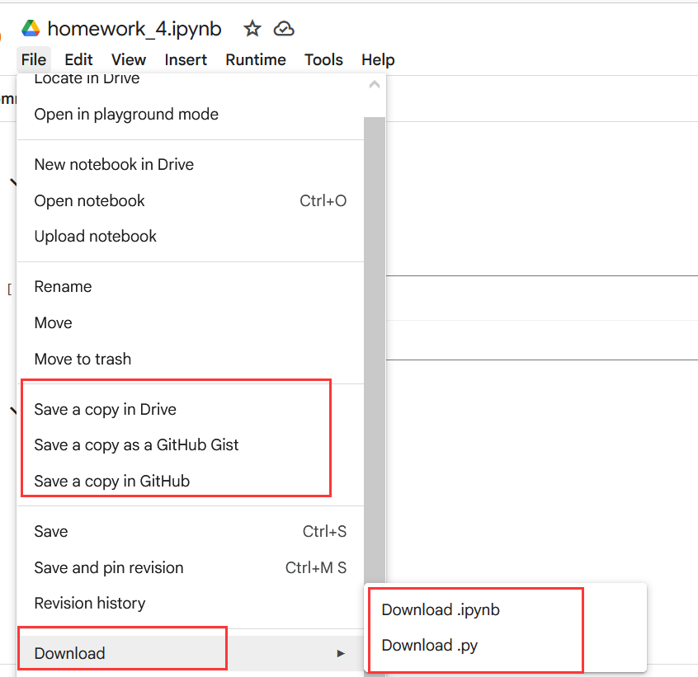
Google Colab
Save and export the notebook
The original version is automatically saved.
You can also save a copy to Google Drive or GitHub.
It can be downloaded to your local machine in two formats: .ipynb or .py.

Slide 50
Variables

Slide 51
Variables
Labels (names) for values and computations
Variables reference values
Placeholders
Assignment of values with =
<Variable name> = <Assigned value>
Transient (temporary) storage of values
Lifetime ends with the end of the program execution
Start value is needed, after that we can change to arbitrary values
Mutable
number = 123 message = 'Hello World!'
number2 = number

Slide 52
Variables
Naming conventions for variable names
Fixed rules (if not followed results in errors)
Only letters, numbers and underscore _
No numbers at the beginning
No whitespaces
Style guidelines
Lower case, short and descriptive
Words separated with underscore _
https://github.com/dhelic/focsp/blob/main/style.md
Notebook examples

Slide 53
Variables and data types
Data type | Function | Examples
int | Natural numbers | x = 3
float | Floating point numbers | x = 3.0
bool | Booleans | x = True x = False
str | Strings | x = 'Test' x = "Test"
tuple | Tuples | x = (1, 2, 3)
list | Lists | x = [1, 2, 3]
dict | Dictionaries | x = {1: 'blue', 2: 'red'}
io.TextIOWrapper | Files | x = open('readme.txt')
... | ... | ...

Slide 54
Integers and Floats

Slide 55
Integers and floating point numbers
Integers:
1, -13, 15, -42, 12345, ...
Floats:
1.3, 3.14159, -42.123, …
Arithemtic operations:
Adding (+), Subtracting (-), Multiplying (*), Dividing (/)
Exponantiating (**)
Modulo Operator (%)
number = 5 + 13
number_2 = number + 5

Slide 56
Extended operators
Arithemtic operations with direct assignement:
Adding (+=), Subtracting (-=), Multiplying (*=), Dividing (/=)
number = 42
number += 8 # => 50
number -= 10 # => 40
number /= 4 # => 10
number *= 2 # => 20
number = 42
number = number + 8
number = number - 10
number = number / 4
number = number * 2

Slide 57
Some special cases
Operations with integers and Float == Float
4/2 = 2.0, 2 * 3.0 = 6.0, 3.0 ** 2 = 9.0
Floating point error
0.2 + 0.1 ≠ 0.3
See unit4.ipynb on Moodle

Slide 58
Strings

Slide 59
Strings
Text = sequence of characters
Begin and end marked with quotation marks " or '
string = 'This is a string'
string = "This is also a string"
string = '"Python" was named after "Monty Python".'
string = '''This is a multiline
string'''
string = """This is another multiline
string"""

Slide 60
Strings
Accessing
Individual characters: [] and an index (0-based!)
First character = index 0
Last character = length of the string – 1
Multiple characters with slicing: [], : and indices
Length: len(string)

Slide 61
String slicing
Slicing
Retreive the i-th character:
string[i]
Retrieve a substring with characters from start (inclusive) until end (exclusive):
string[start:end]
Retrieve a substring with characters from start (inclusive) until end (exclusive) in steps of the given size:
string[start:end:stepsize]

Slide 62
String slicing
Advanced slicing
Retreive the i-th last character:
string[-i]
Retrieve everything from the i-th last character (inclusive):
string[-i:]
Retrieve everything until the i-th last character (exclusive):
string[:-i]
Reversed string:
string[::-1]

Slide 63
String slicing: example
text = 'Vienna'
Command with text | Result
text[0] | 'V'
text[:2] text[0:2] | 'Vi'
text[6] | IndexError
text[5] text[-1] | 'a'
text[2:] text[2:6] | 'enna'
text[::2] | 'Ven'
text[::-1] | 'anneiV'

Slide 64
String methods
Strings are flexible with a huge standard functionality
Methods take actions on the variable values
Examples:
Notebook examples
Call | Result
name + ' , hi!' | 'John Doe, hi!'
text * 2 | ' Python! Python! '
name.title() | 'John Doe'
name.upper() | 'JOHN DOE'
text.lower() | ' python! '
text.rstrip() | ' Python!'
text.lstrip() | 'Python! '
text.strip() | 'Python!'
name.split(' ') | ['John', 'Doe']
text = ' Python! '
name = 'John Doe'

Slide 65
Casting, Printing, Commenting, None-Keyword

Slide 66
Conversion between data types
num1 = 123
num2 = '15'
num3 = num1 + num2
Casting: converting between data types
int(), str(), float(), bool()…
Examples:
int('5') => 5
float('5.23') => 5.23
str(5) => '5'
int(True) => 1
bool(0) => False
Output:
TypeError
1 num1 = 123
2 num2 = '15'
--> 3 num3 = num1 + num2
TypeError: unsupported operand type(s) for +: 'int' and 'str'
Solution:
num1 = 123
num2 = '15'
num3 = num1 + int(num2)

Slide 67
Formatting output
print() function
Prints also a new line at the end
Parameters separated with ,
Space character as a whitespace
We can also print and format variables
f before the string to print
Variables in brackets {}
name = 'Max' age = 20 print(f'My name is {name} and I am {age} years old')
Output: My name is Max and I am 20 years old

Slide 68
Formatting output
Whitespaces and special characters
Sequence | Result
\n | New line
\t | Tabulator
\' | ' character in strings
\" | " character in strings
\\ | \ character (backslash)

Slide 69
Comments
Syntax
# single-line comment
""" multi line
comment """
''' multi line
documentation '''
Explanations to program flow and structure
Supports understanding of the program
Useful for group projects, longer lasting projects, etc.

Slide 70
None-Keyword
None
No value, Null value
Placeholder when the variable value is still not assigned
x = None is different than:
0
False
''
Notebook examples

Slide 71
Boolean variables and operators

Slide 72
Boolean variables
Boolean variables (boolean, bool) store true/false values
True
False
Boolean variables are results of comparisons of other variables
value = ((2 + 2) < 4)
print('This is', value)

Slide 73
Comparison operators
Operator | Description | Example
== | is equal | x == y
!= | is not equal | x != y
> | greater than | x > y
< | smaller than | x < y
>= | greater or equal | x >= y
<= | smaller or equals | x <= y
is | objects are identical | x is y
is not | objects are different | x is not y
Result of comparisons: Boolean value (True oder False)

Slide 74
Logical operators
Operator | Description | Example
and | True iff both statements are true | x == y and y < 5
or | False iff both statement are false | x > 2 or y > 3
not | Negation of the statement | not x == y not z
^ | True iff one of the statements is true (XOR) | x == 2 ^ y < 4
Note that ^ is so-called bitwise operator
Works on bits
Result of each comparison is a boolean value
Hence, this should work as expected

Slide 75
Operator precedence
Operator precedence (from low to high)
or
and
not
in, not in, is, is not, <, <=, >, >=, !=, ==
|
^
&
<<, >>
+, -
*, @, /, //, %
+x, -x, ~x
**
If not sure: ()
Notebook examples

Slide 76
Conditions (if-Statements)

Slide 77
Branching: if statements
Checking whether conditions are satisfied
Conditional execution of code
Control flow
If condition satisfied then do something
Syntax:
if condition:
print('Do something')
if x > 2: print('In if')
print('Not in if')
Indented 4 spaces

Slide 78
Branching: if-else statements
If statement with a fallback
In case the condition is not fullfilled
If condition satisfied then do something else do something else
Syntax:
if condition:
print('Do something')
else:
print('Do something else')
if x > 2: print('In if')
else:
print('In else')

Slide 79
Branching: if-elif-else statements
Multiple branching for more complex case
If first condition satisfied then do something
else if second condition then do something else
else if third condition then do somenthing else than before
…
else do something completly different

Slide 80
Branching: if-elif-else statements
Syntax:
if condition:
print('Do something')
elif condition2:
print('Do something else')
elif condition3:
print('Do something different')
# there could be more elifs below this
else: # optional
print('Do something completely different')

Slide 81
Branching: if-elif-else statements
Examples:
if x < 5: print('Small')
elif x < 15: print('Medium')
elif x < 20: print('Big')
else: print('Huge')
if x < 5: print('Small')
if x < 15: print('Medium')
if x < 20: print('Big')
else: print('Huge')
≠

Slide 82
Indentation rules
Standard PEP8 (https://peps.python.org/pep-0008/)
4 spaces, no tabulators (configure editors to replaces tabs with 4 spaces)
Block indentation
Everything that is indented after : belongs to the current block
This is language syntax!
Not following the syntax results in an error
Implicitly: supports formatting and readability of code
Changes the relation to the rest of the code
if, for, while, def, …

Slide 83
Nested indentation
Code blocks can be arbitrarly nested at multiple levels
age_max = 35
age_peter = 42
age_berta = 37
if age_max < age_peter:
print('Max is younger than Peter')
if age_berta < age_max:
print('Berta is the youngest!')
else:
print('Max is the youngest!')
else:
if age_berta < age_peter:
print('Berta is the youngest!')
else:
print('Peter is the youngest!')
Notebook examples

Slide 84
Exercise

Slide 85
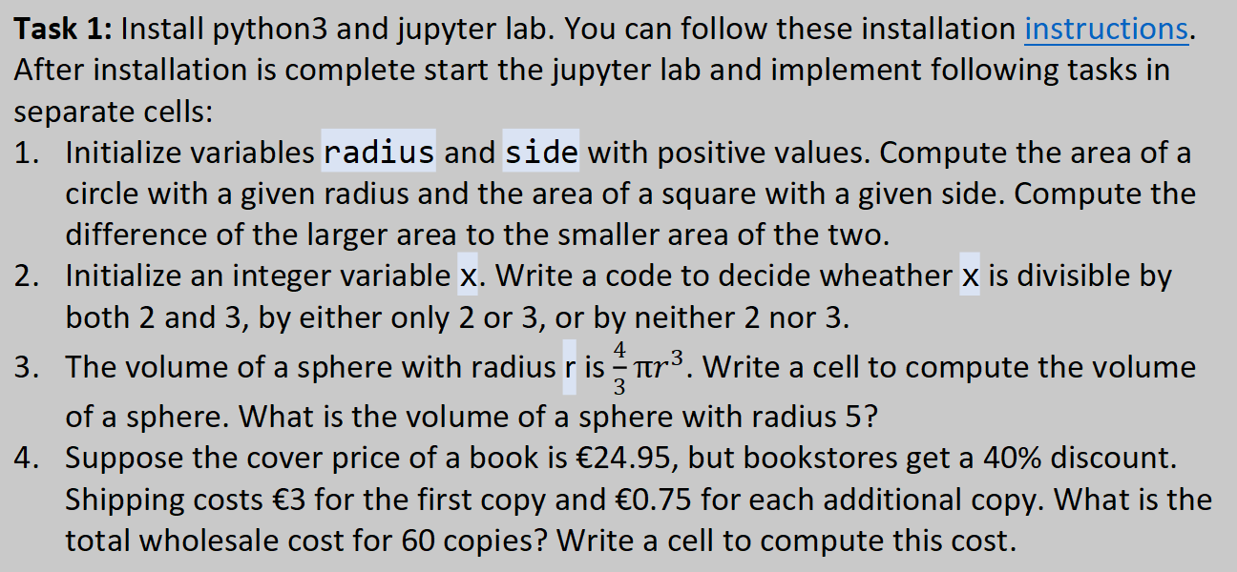
Student task
Task 1: Install python3 and jupyter lab. You can follow these installation instructions. After installation is complete start the jupyter lab and implement following tasks in separate cells:
Initialize variables radius and side with positive values. Compute the area of a circle with a given radius and the area of a square with a given side. Compute the difference of the larger area to the smaller area of the two.
Initialize an integer variable x. Write a code to decide wheather x is divisible by both 2 and 3, by either only 2 or 3, or by neither 2 nor 3.
The volume of a sphere with radius r is $\frac{4}{3}πr^{3}$. Write a cell to compute the volume of a sphere. What is the volume of a sphere with radius 5?
Suppose the cover price of a book is €24.95, but bookstores get a 40% discount. Shipping costs €3 for the first copy and €0.75 for each additional copy. What is the total wholesale cost for 60 copies? Write a cell to compute this cost.

